Slide 1
Chapter 10: Virtual Memory

Slide 2
Chapter 10: Virtual Memory
Background
Demand Paging
Copy-on-Write
Page Replacement
Allocation of Frames
Thrashing
Memory-Mapped Files
Allocating Kernel Memory
Other Considerations
Operating-System Examples

Slide 3
Objectives
Define virtual memory and describe its benefits.
Illustrate how pages are loaded into memory using demand paging.
Apply the FIFO, optimal, and LRU page-replacement algorithms.
Describe the working set of a process, and explain how it is related to program locality.
Describe how Linux, Windows 10, and Solaris manage virtual memory.
Design a virtual memory manager simulation in the C programming language.

Slide 4
Background
Code needs to be in memory to execute, but entire program rarely used
  Error code, unusual routines, large data structures
Entire program code not needed at same time
Consider ability to execute partially-loaded program
  Program no longer constrained by limits of physical memory
  Each program takes less memory while running -> more programs run at the same time
    Increased CPU utilization and throughput with no increase in response time or turnaround time
  Less I/O needed to load or swap programs into memory -> each user program runs faster

Slide 5
Virtual memory
Virtual memory – separation of user logical memory from physical memory
  Only part of the program needs to be in memory for execution
  Logical address space can therefore be much larger than physical address space
  Allows address spaces to be shared by several processes
  Allows for more efficient process creation
  More programs running concurrently
  Less I/O needed to load or swap processes

Slide 6
Virtual memory (Cont.)
Virtual address space – logical view of how process is stored in memory
  Usually start at address 0, contiguous addresses until end of space
  Meanwhile, physical memory organized in page frames
  MMU must map logical to physical
Virtual memory can be implemented via:
  Demand paging
  Demand segmentation

Slide 7
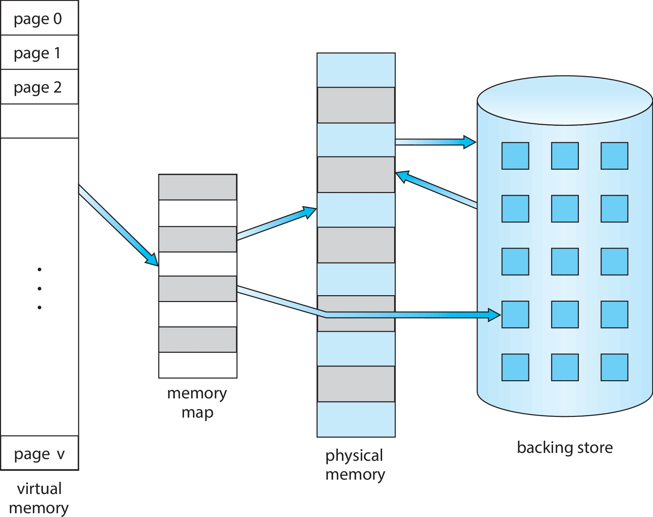
Virtual Memory That is Larger Than Physical Memory

Slide 8
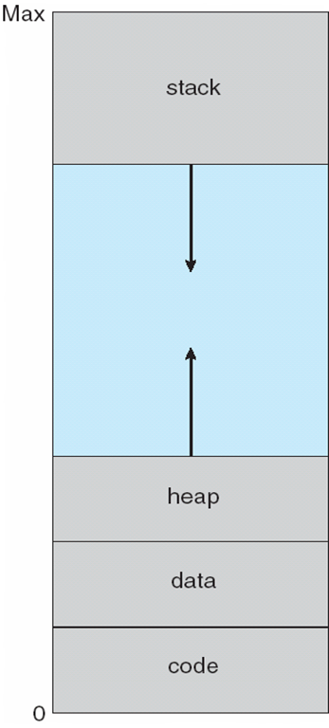
Virtual-address Space
Usually design logical address space for stack to start at Max logical address and grow “down” while heap grows “up”
  Maximizes address space use
  Unused address space between the two is hole
    No physical memory needed until heap or stack grows to a given new page
Enables sparse address spaces with holes left for growth, dynamically linked libraries, etc.
System libraries shared via mapping into virtual address space
Shared memory by mapping pages read-write into virtual address space
Pages can be shared during fork(), speeding process creation

Slide 9
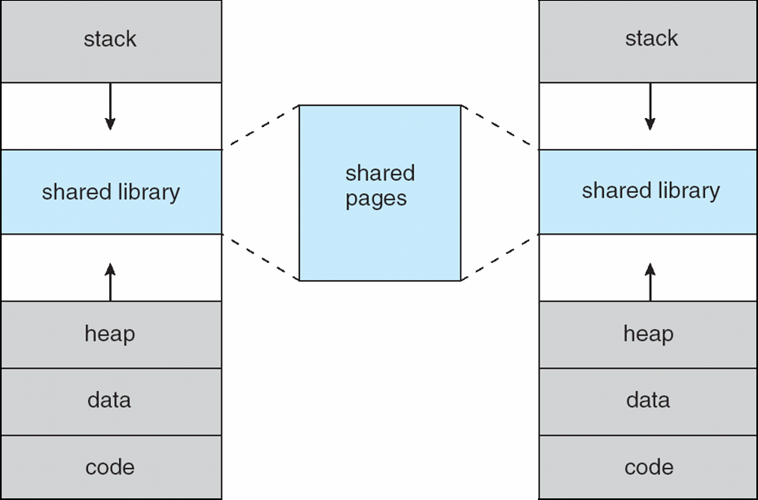
Shared Library Using Virtual Memory

Slide 10
Demand Paging 1
Could bring entire process into memory at load time
Or bring a page into memory only when it is needed
  Less I/O needed, no unnecessary I/O
  Less memory needed
  Faster response
  More users
Similar to paging system with swapping (diagram on right)
Page is needed ⇒ reference to it
  invalid reference ⇒ abort
  not-in-memory ⇒ bring to memory
Lazy swapper – never swaps a page into memory unless page will be needed
  Swapper that deals with pages is a pager

Slide 11
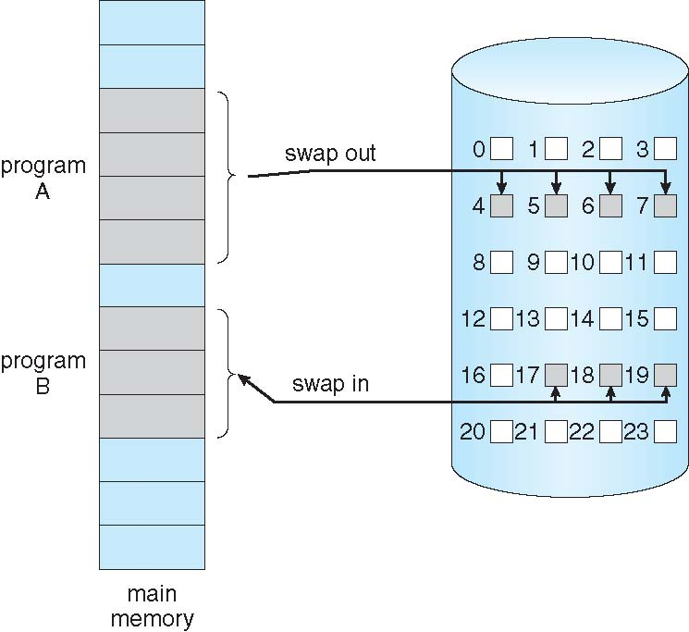
Demand Paging
Could bring entire process into memory at load time
Or bring a page into memory only when it is needed
  Less I/O needed, no unnecessary I/O
  Less memory needed
  Faster response
  More users
Similar to paging system with swapping (diagram on right)

Slide 12
Basic Concepts
With swapping, pager guesses which pages will be used before swapping out again
Instead, pager brings in only those pages into memory
How to determine that set of pages?
  Need new MMU functionality to implement demand paging
If pages needed are already memory resident
  No difference from non demand-paging
If page needed and not memory resident
  Need to detect and load the page into memory from storage
    Without changing program behavior
    Without programmer needing to change code

Slide 13
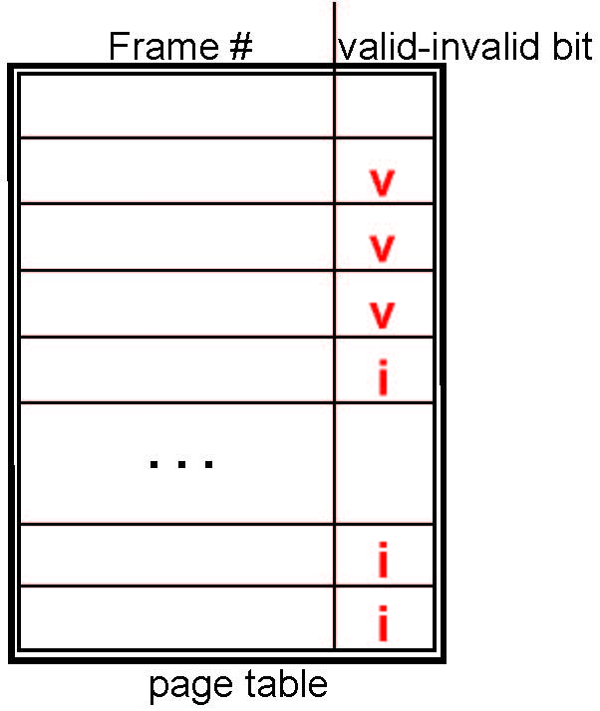
Valid-Invalid Bit
With each page table entry a valid–invalid bit is associated
(v ⇒ in-memory – memory resident, i ⇒ not-in-memory)
Initially valid–invalid bit is set to i on all entries
Example of a page table snapshot:
During MMU address translation, if valid–invalid bit in page table entry is i ⇒ page fault

Slide 14
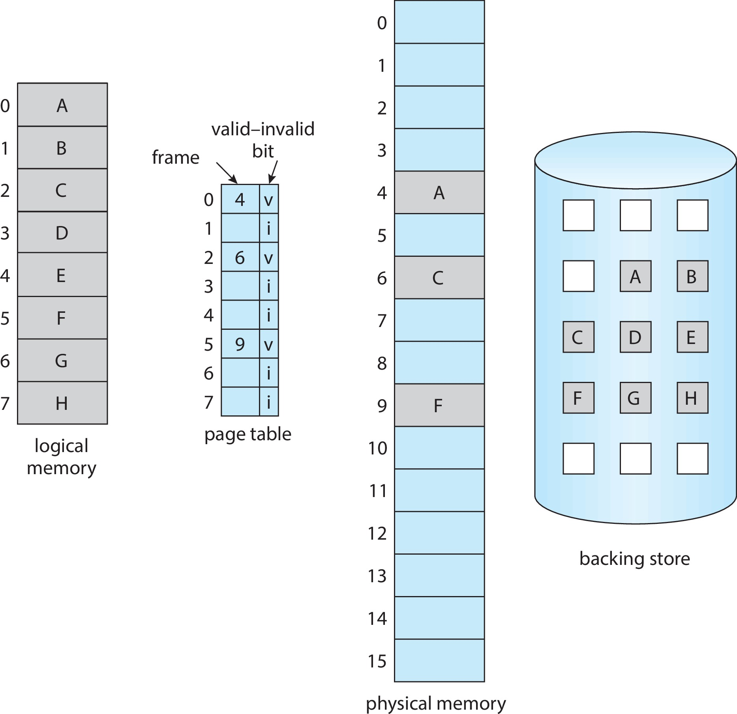
Page Table When Some Pages Are Not in Main Memory

Slide 15
Steps in Handling Page Fault
If there is a reference to a page, first reference to that page will trap to operating system
  Page fault
Operating system looks at another table to decide:
  Invalid reference ⇒ abort
  Just not in memory
Find free frame
Swap page into frame via scheduled disk operation
Reset tables to indicate page now in memory
Set validation bit = v
Restart the instruction that caused the page fault

Slide 16
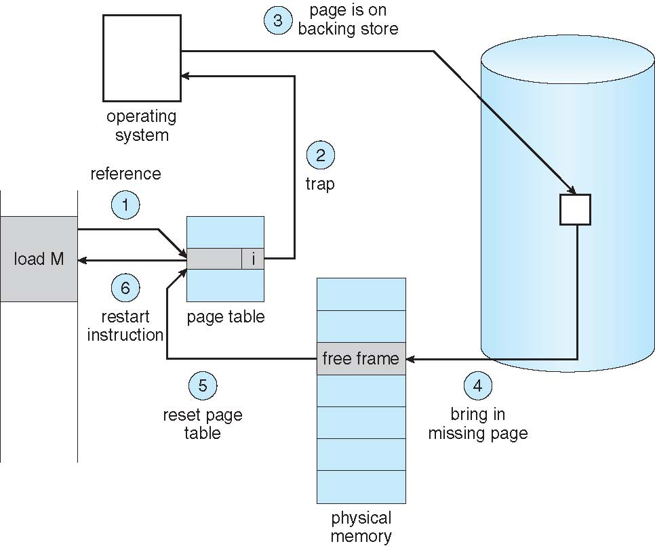
Steps in Handling a Page Fault (Cont.)

Slide 17
Aspects of Demand Paging
Extreme case – start process with no pages in memory
  OS sets instruction pointer to first instruction of process, non-memory-resident -> page fault
  And for every other process pages on first access
  Pure demand paging
Actually, a given instruction could access multiple pages -> multiple page faults
  Consider fetch and decode of instruction which adds 2 numbers from memory and stores result back to memory
  Pain decreased because of locality of reference
Hardware support needed for demand paging
  Page table with valid / invalid bit
  Secondary memory (swap device with swap space)
  Instruction restart

Slide 18
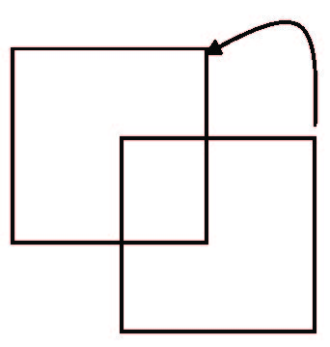
Instruction Restart
Consider an instruction that could access several different locations
  Block move
  Auto increment/decrement location
  Restart the whole operation?
    What if source and destination overlap?

Slide 19
Free-Frame List
When a page fault occurs, the operating system must bring the desired page from secondary storage into main memory.
Most operating systems maintain a free-frame list -- a pool of free frames for satisfying such requests.
Operating system typically allocate free frames using a technique known as zero-fill-on-demand -- the content of the frames zeroed-out before being allocated.
When a system starts up, all available memory is placed on the free-frame list.

Slide 20
Stages in Demand Paging – Worse Case
Trap to the operating system
Save the user registers and process state
Determine that the interrupt was a page fault
Check that the page reference was legal and determine the location of the page on the disk
Issue a read from the disk to a free frame:
  Wait in a queue for this device until the read request is serviced
  Wait for the device seek and/or latency time
  Begin the transfer of the page to a free frame

Slide 21
Stages in Demand Paging (Cont.)
While waiting, allocate the CPU to some other user
Receive an interrupt from the disk I/O subsystem (I/O completed)
Save the registers and process state for the other user
Determine that the interrupt was from the disk
Correct the page table and other tables to show page is now in memory
Wait for the CPU to be allocated to this process again
Restore the user registers, process state, and new page table, and then
resume the interrupted instruction

Slide 22
Performance of Demand Paging
Three major activities
  Service the interrupt – careful coding means just several hundred instructions needed
  Read the page – lots of time
  Restart the process – again just a small amount of time
Page Fault Rate 0 ≤ p ≤ 1
  if p = 0 no page faults
  if p = 1, every reference is a fault
Effective Access Time (EAT)
EAT = (1 – p) x memory access
+ p (page fault overhead
+ swap page out
+ swap page in )

Slide 23
Demand Paging Example 1
Memory access time = 200 nanoseconds
Average page-fault service time = 8 milliseconds
EAT = (1 – p) x 200 + p (8 milliseconds)
= (1 – p x 200 + p x 8,000,000
= 200 + p x 7,999,800
If one access out of 1,000 causes a page fault, then
EAT = 8.2 microseconds.
This is a slowdown by a factor of 40!!
If want performance degradation < 10 percent
  220 > 200 + 7,999,800 x p
  20 > 7,999,800 x p
  p < .0000025
  < one page fault in every 400,000 memory accesses

Slide 24
Demand Paging Optimizations
Swap space I/O faster than file system I/O even if on the same device
  Swap allocated in larger chunks, less management needed than file system
Copy entire process image to swap space at process load time
  Then page in and out of swap space
  Used in older BSD Unix
Demand page in from program binary on disk, but discard rather than paging out when freeing frame
  Used in Solaris and current BSD
  Still need to write to swap space
    Pages not associated with a file (like stack and heap) – anonymous memory
    Pages modified in memory but not yet written back to the file system
Mobile systems
  Typically don’t support swapping
  Instead, demand page from file system and reclaim read-only pages (such as code)

Slide 25
Copy-on-Write
Copy-on-Write (COW) allows both parent and child processes to initially share the same pages in memory
  If either process modifies a shared page, only then is the page copied
COW allows more efficient process creation as only modified pages are copied
In general, free pages are allocated from a pool of zero-fill-on-demand pages
  Pool should always have free frames for fast demand page execution
    Don’t want to have to free a frame as well as other processing on page fault
  Why zero-out a page before allocating it?
vfork() variation on fork() system call has parent suspend and child using copy-on-write address space of parent
  Designed to have child call exec()
  Very efficient

Slide 26
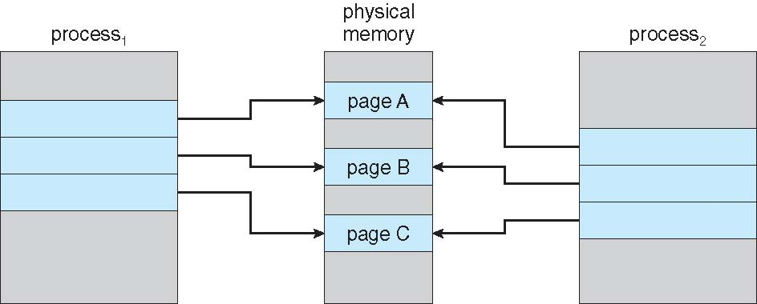
Before Process 1 Modifies Page C

Slide 27
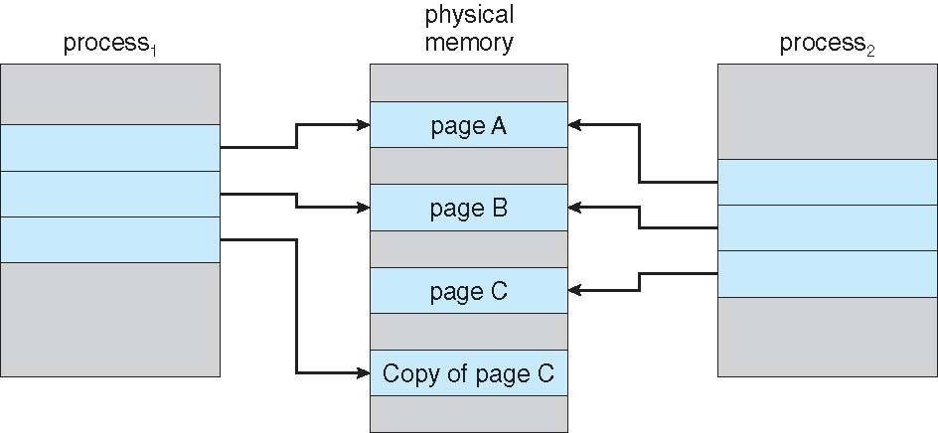
After Process 1 Modifies Page C

Slide 28
What Happens if There is no Free Frame?
Used up by process pages
Also in demand from the kernel, I/O buffers, etc
How much to allocate to each?
Page replacement – find some page in memory, but not really in use, page it out
  Algorithm – terminate? swap out? replace the page?
  Performance – want an algorithm which will result in minimum number of page faults
Same page may be brought into memory several times

Slide 29
Page Replacement 1
Prevent over-allocation of memory by modifying page-fault service routine to include page replacement
Use modify (dirty) bit to reduce overhead of page transfers – only modified pages are written to disk
Page replacement completes separation between logical memory and physical memory – large virtual memory can be provided on a smaller physical memory

Slide 30
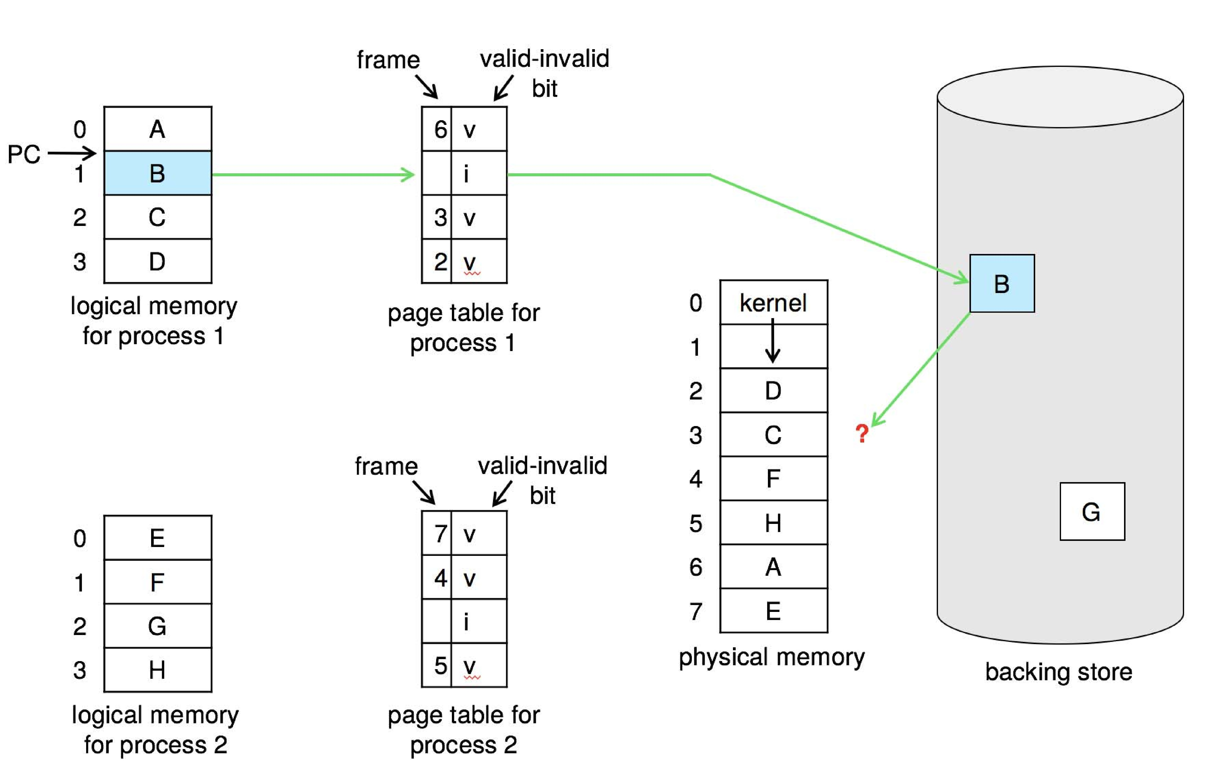
Need For Page Replacement

Slide 31
Basic Page Replacement
Find the location of the desired page on disk
Find a free frame:
- If there is a free frame, use it
- If there is no free frame, use a page replacement algorithm to select a victim frame
- Write victim frame to disk if dirty
Bring the desired page into the (newly) free frame; update the page and frame tables
Continue the process by restarting the instruction that caused the trap
Note now potentially 2 page transfers for page fault – increasing EAT

Slide 32
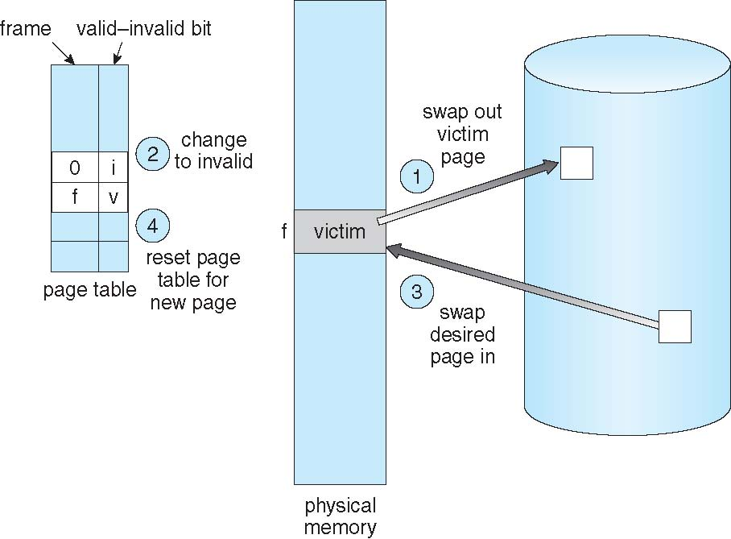
Page Replacement

Slide 33
Page and Frame Replacement Algorithms
Frame-allocation algorithm determines
  How many frames to give each process
  Which frames to replace
Page-replacement algorithm
  Want lowest page-fault rate on both first access and re-access
Evaluate algorithm by running it on a particular string of memory references (reference string) and computing the number of page faults on that string
  String is just page numbers, not full addresses
  Repeated access to the same page does not cause a page fault
  Results depend on number of frames available
In all our examples, the reference string of referenced page numbers is
7,0,1,2,0,3,0,4,2,3,0,3,0,3,2,1,2,0,1,7,0,1

Slide 34
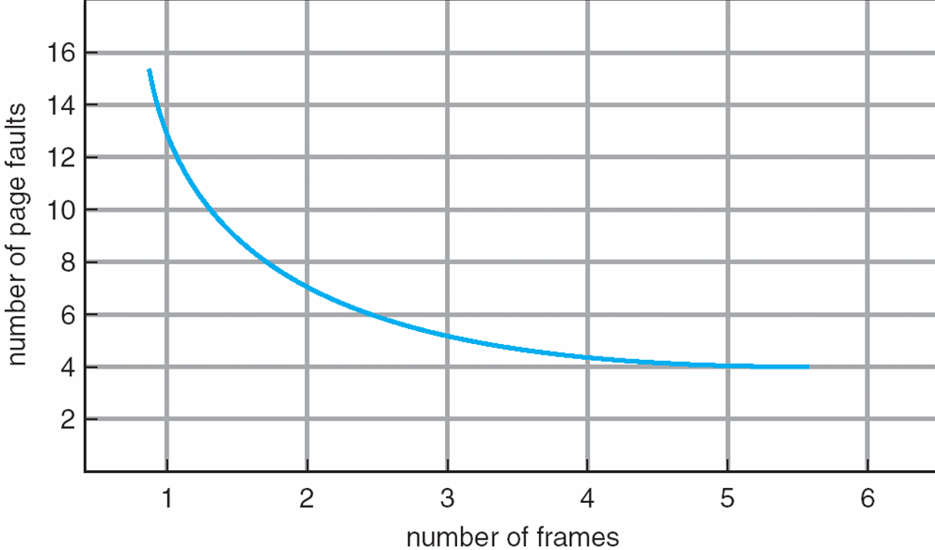
Graph of Page Faults Versus the Number of Frames

Slide 35
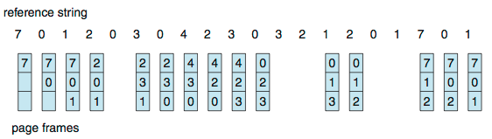
First-In-First-Out (FIFO) Algorithm 1
Reference string: 7,0,1,2,0,3,0,4,2,3,0,3,0,3,2,1,2,0,1,7,0,1
3 frames (3 pages can be in memory at a time per process)
Can vary by reference string: consider 1,2,3,4,1,2,5,1,2,3,4,5
  Adding more frames can cause more page faults!
    Belady’s Anomaly
How to track ages of pages?
  Just use a FIFO queue
15 page faults

Slide 36
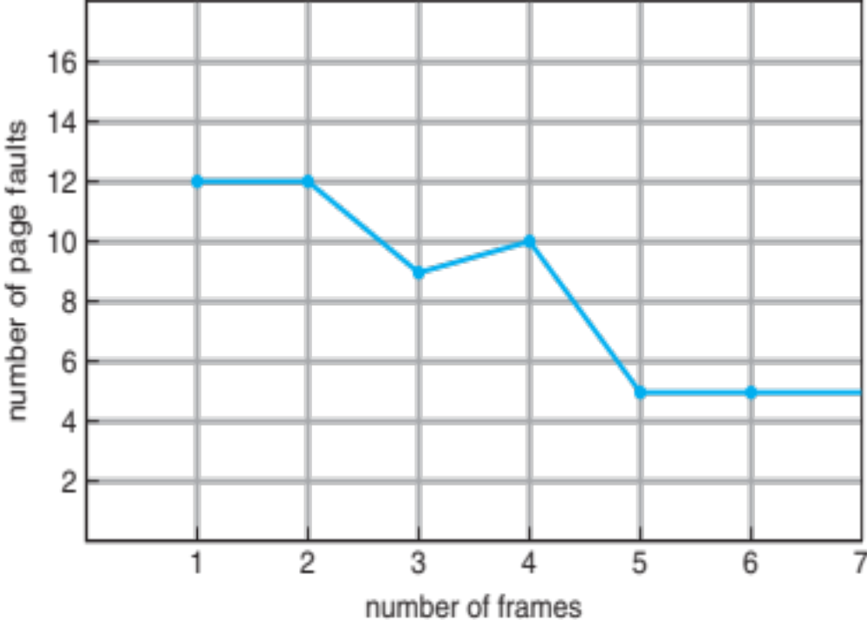
FIFO Illustrating Belady’s Anomaly

Slide 37
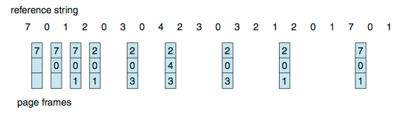
Optimal Algorithm
Replace page that will not be used for longest period of time
  9 is optimal for the example
How do you know this?
  Can’t read the future
Used for measuring how well your algorithm performs
Thus, Hit ratio = Total number of page hits / Total number of references

Slide 38
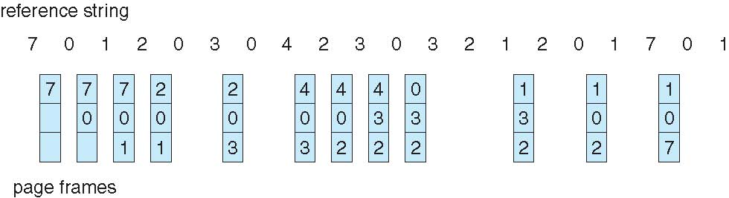
Least Recently Used (LRU) Algorithm
Use past knowledge rather than future
Replace page that has not been used in the most amount of time
Associate time of last use with each page
12 faults – better than FIFO but worse than OPT
Generally good algorithm and frequently used
But how to implement?

Slide 39
LRU Algorithm (Cont.)
Counter implementation
  Every page entry has a counter; every time page is referenced through this entry, copy the clock into the counter
  When a page needs to be changed, look at the counters to find smallest value
    Search through table needed
Stack implementation
  Keep a stack of page numbers in a double link form:
  Page referenced:
    move it to the top
    requires 6 pointers to be changed
  But each update more expensive
  No search for replacement

Slide 40
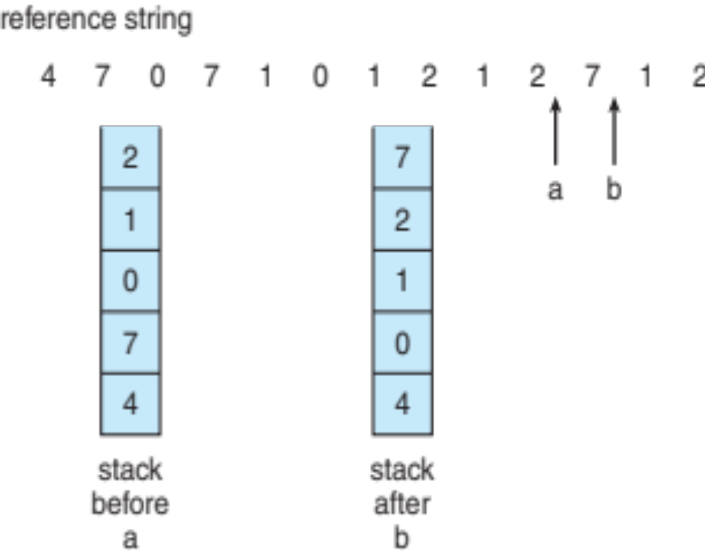
LRU Algorithm (Cont.)
LRU and OPT are cases of stack algorithms that don’t have Belady’s Anomaly
Use Of A Stack to Record Most Recent Page References

Slide 41
LRU Approximation Algorithms
LRU needs special hardware and still slow
Reference bit
  With each page associate a bit, initially = 0
  When page is referenced bit set to 1
  Replace any with reference bit = 0 (if one exists)
    We do not know the order, however

Slide 42
LRU Approximation Algorithms (cont.)
Second-chance algorithm
  Generally FIFO, plus hardware-provided reference bit
  Clock replacement
  If page to be replaced has
    Reference bit = 0 -> replace it
    reference bit = 1 then:
      set reference bit 0, leave page in memory
      replace next page, subject to same rules

Slide 43
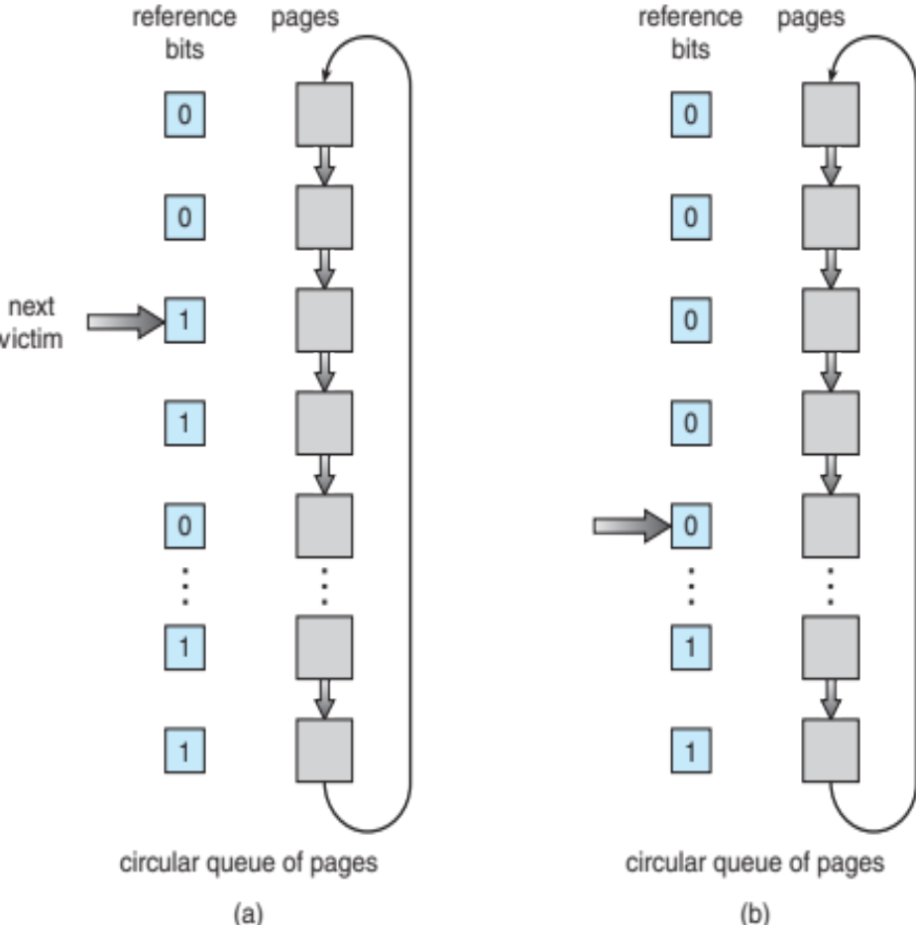
Second-chance Algorithm 1

Slide 44
Second-chance Algorithm
reference string : 7,0,1,2,0,3,0,4,2,3,0,3
page falt :

Slide 45
Enhanced Second-Chance Algorithm
Improve algorithm by using reference bit and modify bit (if available) in concert
Take ordered pair (reference, modify):
  (0, 0) neither recently used not modified – best page to replace
  (0, 1) not recently used but modified – not quite as good, must write out before replacement
  (1, 0) recently used but clean – probably will be used again soon
  (1, 1) recently used and modified – probably will be used again soon and need to write out before replacement
When page replacement called for, use the clock scheme but use the four classes replace page in lowest non-empty class
  Might need to search circular queue several times

Slide 46
Counting Algorithms
Keep a counter of the number of references that have been made to each page
  Not common
Lease Frequently Used (LFU) Algorithm:
  Replaces page with smallest count
Most Frequently Used (MFU) Algorithm:
  Based on the argument that the page with the smallest count was probably just brought in and has yet to be used

Slide 47
Page-Buffering Algorithms
Keep a pool of free frames, always
  Then frame available when needed, not found at fault time
  Read page into free frame and select victim to evict and add to free pool
  When convenient, evict victim
Possibly, keep list of modified pages
  When backing store otherwise idle, write pages there and set to non-dirty
Possibly, keep free frame contents intact and note what is in them
  If referenced again before reused, no need to load contents again from disk
  Generally useful to reduce penalty if wrong victim frame selected

Slide 48
Applications and Page Replacement
All of these algorithms have OS guessing about future page access
Some applications have better knowledge – i.e. databases
Memory intensive applications can cause double buffering
  OS keeps copy of page in memory as I/O buffer
  Application keeps page in memory for its own work
Operating system can given direct access to the disk, getting out of the way of the applications
  Raw disk mode
Bypasses buffering, locking, etc.

Slide 49
Allocation of Frames
Each process needs minimum number of frames
Example: IBM 370 – 6 pages to handle SS MOVE instruction:
  instruction is 6 bytes, might span 2 pages
  2 pages to handle from
  2 pages to handle to
Maximum of course is total frames in the system
Two major allocation schemes
  fixed allocation
  priority allocation
Many variations

Slide 50
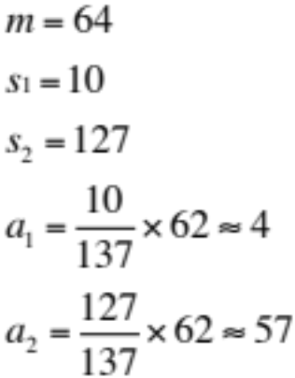
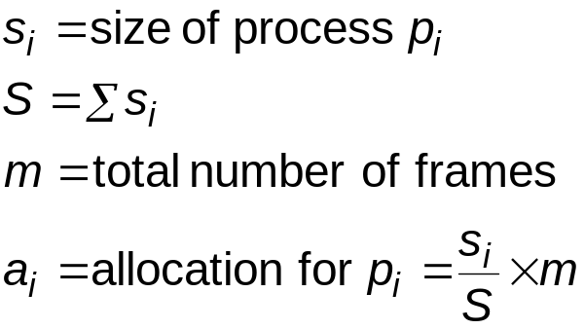
Fixed Allocation
Equal allocation – For example, if there are 100 frames (after allocating frames for the OS) and 5 processes, give each process 20 frames
  Keep some as free frame buffer pool
Proportional allocation – Allocate according to the size of process
  Dynamic as degree of multiprogramming, process sizes change

Slide 51
Global vs. Local Allocation
Global replacement – process selects a replacement frame from the set of all frames; one process can take a frame from another
  But then process execution time can vary greatly
  But greater throughput so more common
Local replacement – each process selects from only its own set of allocated frames
  More consistent per-process performance
  But possibly underutilized memory

Slide 52
Reclaiming Pages
A strategy to implement global page-replacement policy
All memory requests are satisfied from the free-frame list, rather than waiting for the list to drop to zero before we begin selecting pages for replacement,
Page replacement is triggered when the list falls below a certain threshold.
This strategy attempts to ensure there is always sufficient free memory to satisfy new requests.

Slide 53
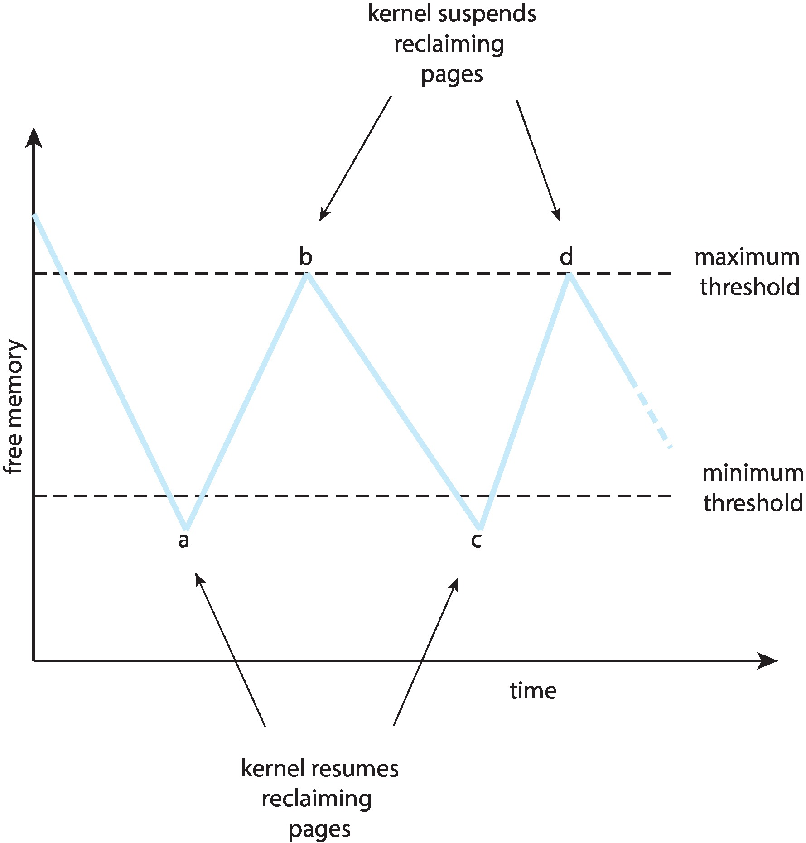
Reclaiming Pages Example

Slide 54
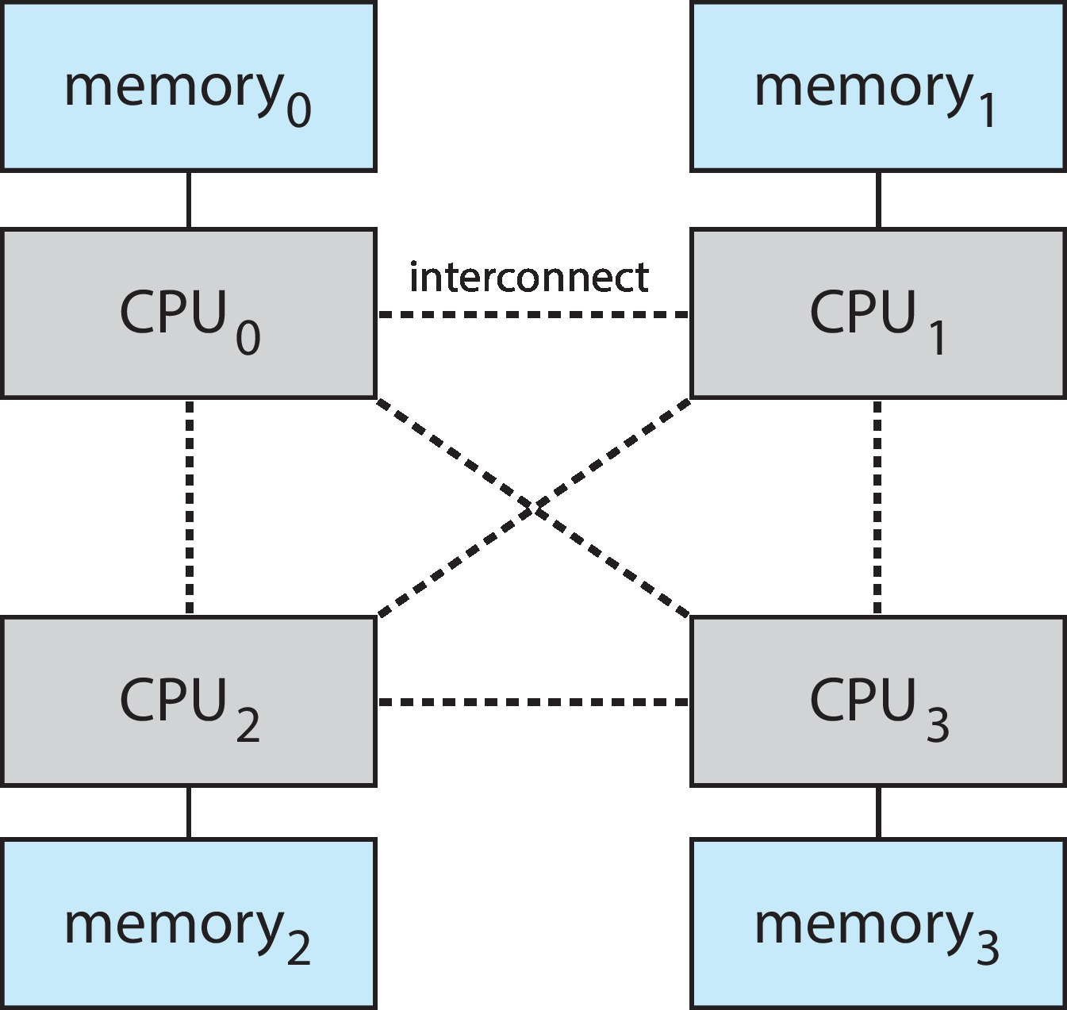
Non-Uniform Memory Access
So far, we assumed that all memory accessed equally
Many systems are NUMA – speed of access to memory varies
  Consider system boards containing CPUs and memory, interconnected over a system bus
NUMA multiprocessing architecture

Slide 55
Non-Uniform Memory Access (Cont.)
Optimal performance comes from allocating memory “close to” the CPU on which the thread is scheduled
  And modifying the scheduler to schedule the thread on the same system board when possible
  Solved by Solaris by creating lgroups
    Structure to track CPU / Memory low latency groups
    Used my schedule and pager
    When possible schedule all threads of a process and allocate all memory for that process within the lgroup

Slide 56
Thrashing
If a process does not have “enough” pages, the page-fault rate is very high
  Page fault to get page
  Replace existing frame
  But quickly need replaced frame back
  This leads to:
    Low CPU utilization
    Operating system thinking that it needs to increase the degree of multiprogramming
    Another process added to the system

Slide 57
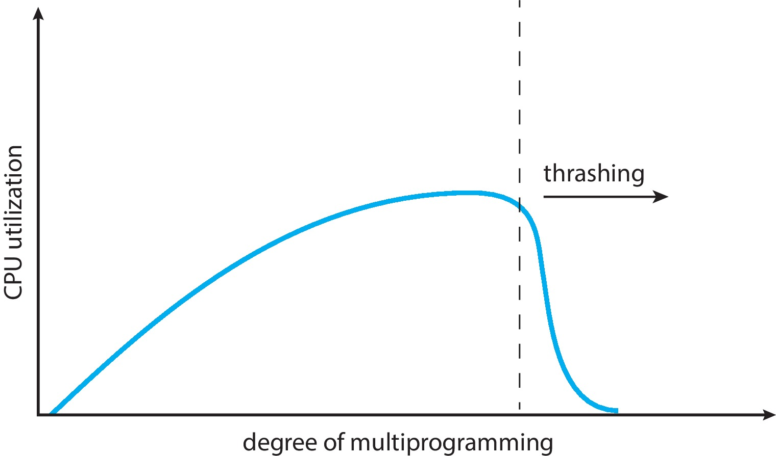
1 Thrashing (Cont.)
Thrashing. A process is busy swapping pages in and out

Slide 58
Demand Paging and Thrashing
Why does demand paging work?
Locality model
  Process migrates from one locality to another
  Localities may overlap
Why does thrashing occur?
Σ size of locality > total memory size
Limit effects by using local or priority page replacement

Slide 59
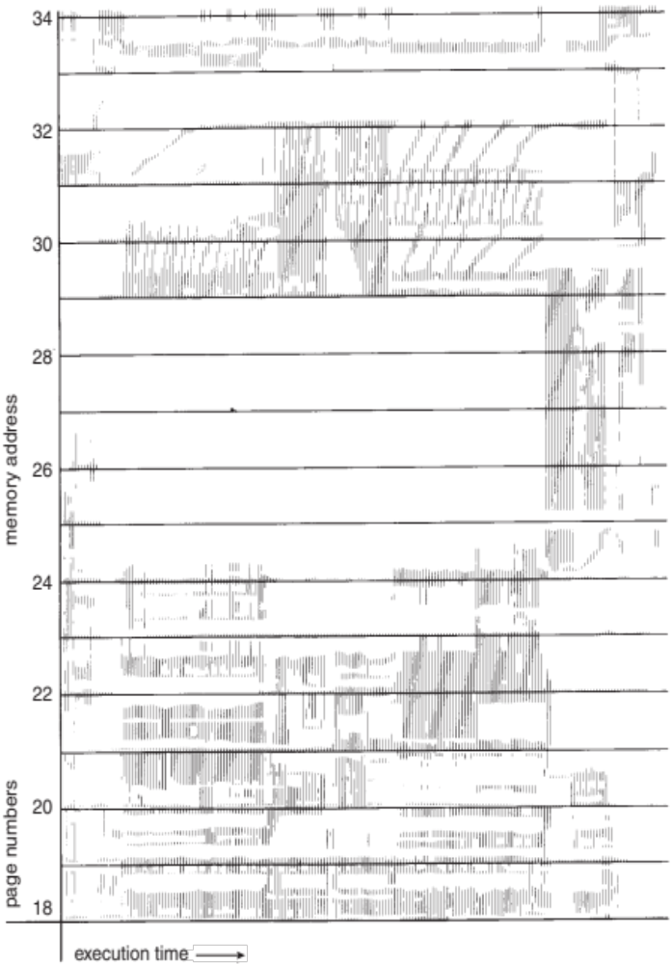
Locality In A Memory-Reference Pattern

Slide 60
Working-Set Model
Δ ≡ working-set window ≡ a fixed number of page references
Example: 10,000 instructions
WSS_{i} (working set of Process P_{i}) = total number of pages referenced in the most recent Δ (varies in time)
  if Δ too small will not encompass entire locality
  if Δ too large will encompass several localities
  if Δ = ∞ ⇒ will encompass entire program
D = Σ WSS_{i} ≡ total demand frames
  Approximation of locality

Slide 61
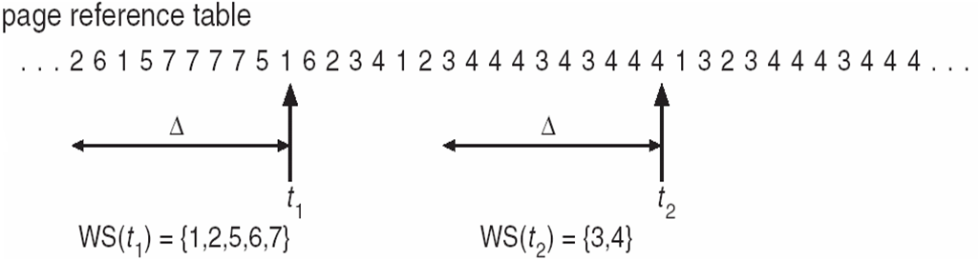
Working-Set Model (Cont.) 1
if D > m ⇒ Thrashing
Policy if D > m, then suspend or swap out one of the processes

Slide 62
Keeping Track of the Working Set
Approximate with interval timer + a reference bit
Example: Δ = 10,000
  Timer interrupts after every 5000 time units
  Keep in memory 2 bits for each page
  Whenever a timer interrupts copy and sets the values of all reference bits to 0
  If one of the bits in memory = 1 ⇒ page in working set
Why is this not completely accurate?
Improvement = 10 bits and interrupt every 1000 time units

Slide 63
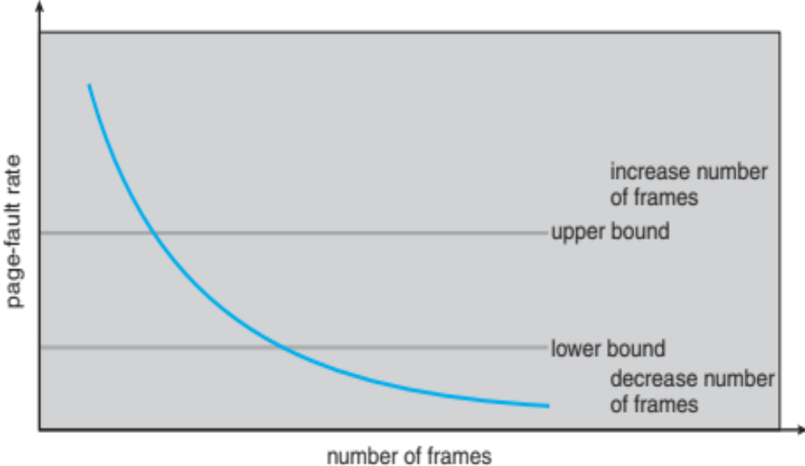
Page-Fault Frequency 1
More direct approach than WSS
Establish “acceptable” page-fault frequency (PFF) rate and use local replacement policy
  If actual rate too low, process loses frame
  If actual rate too high, process gains frame

Slide 64
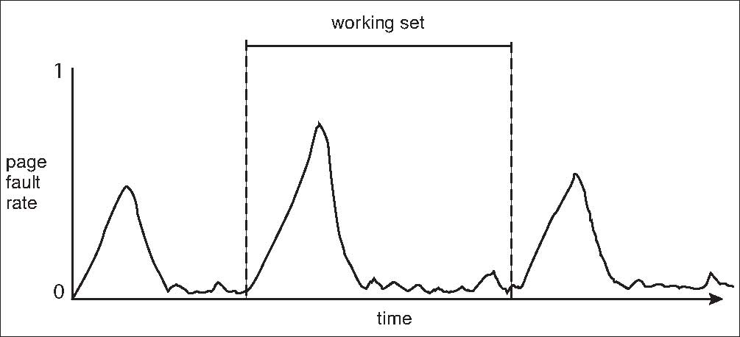
Working Sets and Page Fault Rates 1
Direct relationship between working set of a process and its page-fault rate
Working set changes over time
Peaks and valleys over time

Slide 65
Allocating Kernel Memory
Treated differently from user memory
Often allocated from a free-memory pool
  Kernel requests memory for structures of varying sizes
  Some kernel memory needs to be contiguous
    i.e., for device I/O

Slide 66
Buddy System
Allocates memory from fixed-size segment consisting of physically-contiguous pages
Memory allocated using power-of-2 allocator
  Satisfies requests in units sized as power of 2
  Request rounded up to next highest power of 2
  When smaller allocation needed than is available, current chunk split into two buddies of next-lower power of 2
    Continue until appropriate sized chunk available
For example, assume 256KB chunk available, kernel requests 21KB
  Split into A_{L} _{and} A_{R} of 128KB each
    One further divided into B_{L} and B_{R} of 64KB
      One further into C_{L} and C_{R} of 32KB each – one used to satisfy request
Advantage – quickly coalesce unused chunks into larger chunk
Disadvantage - fragmentation

Slide 67
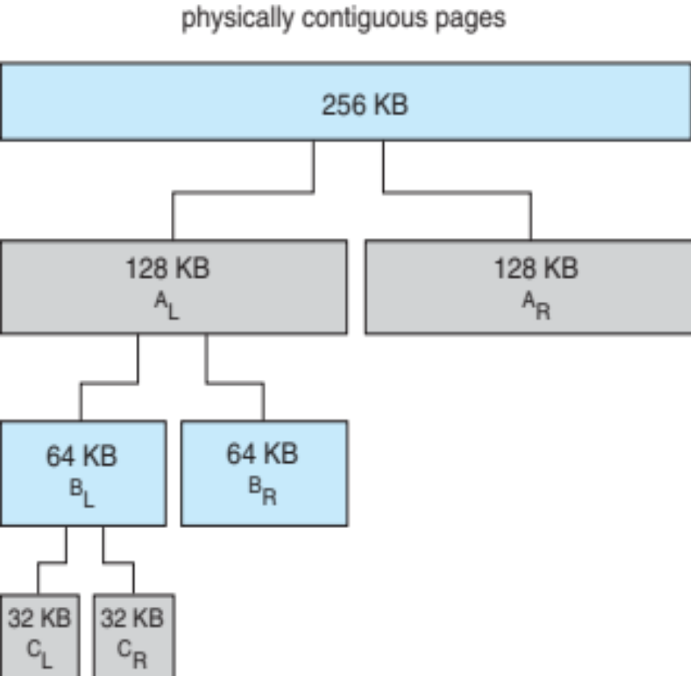
Buddy System Allocator

Slide 68
Slab Allocator
Alternate strategy
Slab is one or more physically contiguous pages
Cache consists of one or more slabs
Single cache for each unique kernel data structure
  Each cache filled with objects – instantiations of the data structure
When cache created, filled with objects marked as free
When structures stored, objects marked as used
If slab is full of used objects, next object allocated from empty slab
  If no empty slabs, new slab allocated
Benefits include no fragmentation, fast memory request satisfaction

Slide 69
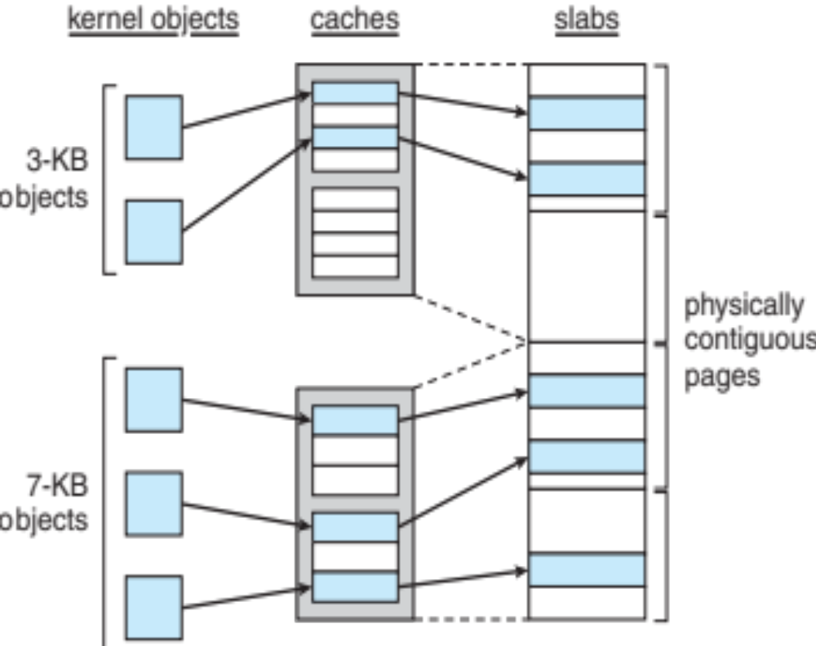
Slab Allocation

Slide 70
Slab Allocator in Linux
For example process descriptor is of type struct task_struct
Approx 1.7KB of memory
New task -> allocate new struct from cache
  Will use existing free struct task_struct
Slab can be in three possible states
  Full – all used
  Empty – all free
  Partial – mix of free and used
Upon request, slab allocator
  Uses free struct in partial slab
  If none, takes one from empty slab
  If no empty slab, create new empty

Slide 71
Slab Allocator in Linux (Cont.)
Slab started in Solaris, now wide-spread for both kernel mode and user memory in various OSes
Linux 2.2 had SLAB, now has both SLOB and SLUB allocators
  SLOB for systems with limited memory
    Simple List of Blocks – maintains 3 list objects for small, medium, large objects
  SLUB is performance-optimized SLAB removes per-CPU queues, metadata stored in page structure

Slide 72
Other Considerations
Prepaging
Page size
TLB reach
Inverted page table
Program structure
I/O interlock and page locking

Slide 73
Prepaging
To reduce the large number of page faults that occurs at process startup
Prepage all or some of the pages a process will need, before they are referenced
But if prepaged pages are unused, I/O and memory was wasted
Assume s pages are prepaged and α of the pages is used
  Is cost of s * α save pages faults > or < than the cost of prepaging
  s * (1- α) unnecessary pages?
  α near zero ⇒ prepaging loses

Slide 74
Page Size
Sometimes OS designers have a choice
  Especially if running on custom-built CPU
Page size selection must take into consideration:
  Fragmentation
  Page table size
  Resolution
  I/O overhead
  Number of page faults
  Locality
  TLB size and effectiveness
Always power of 2, usually in the range 2¹² (4,096 bytes) to 2²² (4,194,304 bytes)
On average, growing over time

Slide 75
TLB Reach
TLB Reach - The amount of memory accessible from the TLB
TLB Reach = (TLB Size) X (Page Size)
Ideally, the working set of each process is stored in the TLB
  Otherwise there is a high degree of page faults
Increase the Page Size
  This may lead to an increase in fragmentation as not all applications require a large page size
Provide Multiple Page Sizes
  This allows applications that require larger page sizes the opportunity to use them without an increase in fragmentation

Slide 76
Program Structure
Program structure
  int[128,128] data;
  Each row is stored in one page
  Program 1
for (j = 0; j <128; j++)
for (i = 0; i < 128; i++)
data[i,j] = 0;
  128 x 128 = 16,384 page faults
  Program 2
  for (i = 0; i < 128; i++)
  for (j = 0; j < 128; j++)
  data[i,j] = 0;
  128 page faults

Slide 77
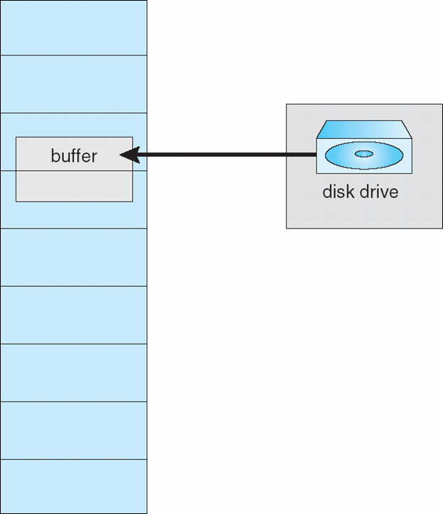
I/O interlock
I/O Interlock – Pages must sometimes be locked into memory
Consider I/O - Pages that are used for copying a file from a device must be locked from being selected for eviction by a page replacement algorithm
Pinning of pages to lock into memory

Slide 78
Operating System Examples
Windows
Solaris

Slide 79
Windows
Uses demand paging with clustering. Clustering brings in pages surrounding the faulting page
Processes are assigned working set minimum and working set maximum
Working set minimum is the minimum number of pages the process is guaranteed to have in memory
A process may be assigned as many pages up to its working set maximum
When the amount of free memory in the system falls below a threshold, automatic working set trimming is performed to restore the amount of free memory
Working set trimming removes pages from processes that have pages in excess of their working set minimum

Slide 80
Solaris
Maintains a list of free pages to assign faulting processes
Lotsfree – threshold parameter (amount of free memory) to begin paging
Desfree – threshold parameter to increasing paging
Minfree – threshold parameter to being swapping
Paging is performed by pageout process
Pageout scans pages using modified clock algorithm
Scanrate is the rate at which pages are scanned. This ranges from slowscan to fastscan
Pageout is called more frequently depending upon the amount of free memory available
Priority paging gives priority to process code pages

Slide 81
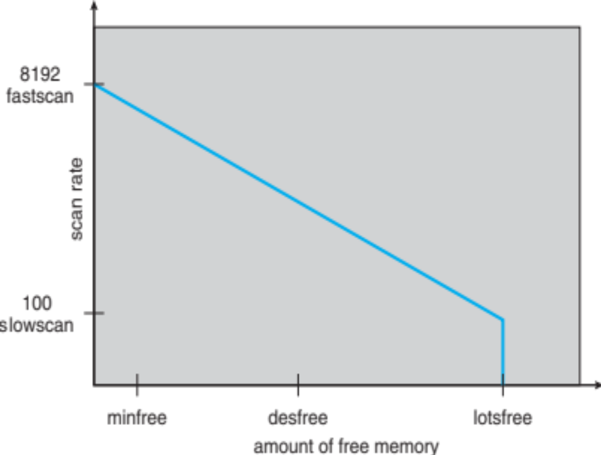
Solaris 2 Page Scanner

Slide 82
End of Chapter 10

Slide 83
Performance of Demand Paging
Stages in Demand Paging (worse case)
Trap to the operating system
Save the user registers and process state
Determine that the interrupt was a page fault
Check that the page reference was legal and determine the location of the page on the disk
Issue a read from the disk to a free frame:
  Wait in a queue for this device until the read request is serviced
  Wait for the device seek and/or latency time
  Begin the transfer of the page to a free frame
While waiting, allocate the CPU to some other user
Receive an interrupt from the disk I/O subsystem (I/O completed)
Save the registers and process state for the other user
Determine that the interrupt was from the disk
Correct the page table and other tables to show page is now in memory
Wait for the CPU to be allocated to this process again
Restore the user registers, process state, and new page table, and then resume the interrupted instruction

Slide 84
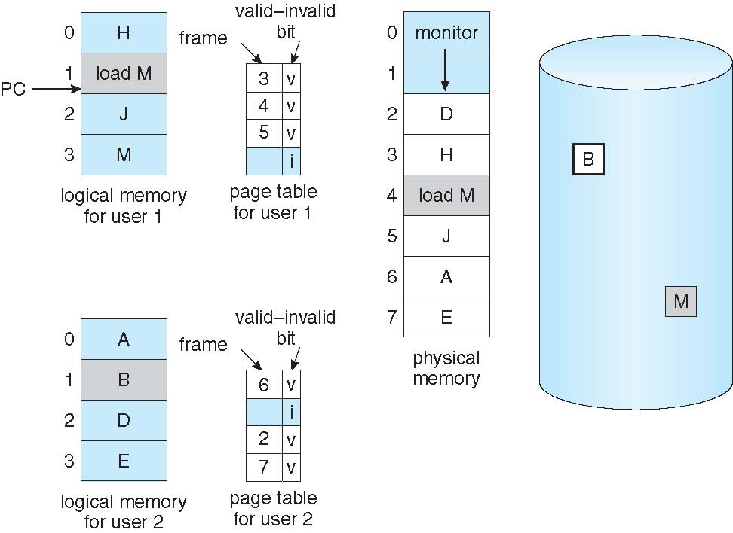
Need For Page Replacement

Slide 85
Priority Allocation
Use a proportional allocation scheme using priorities rather than size
If process P_{i} generates a page fault,
  select for replacement one of its frames
  select for replacement a frame from a process with lower priority number

Slide 86
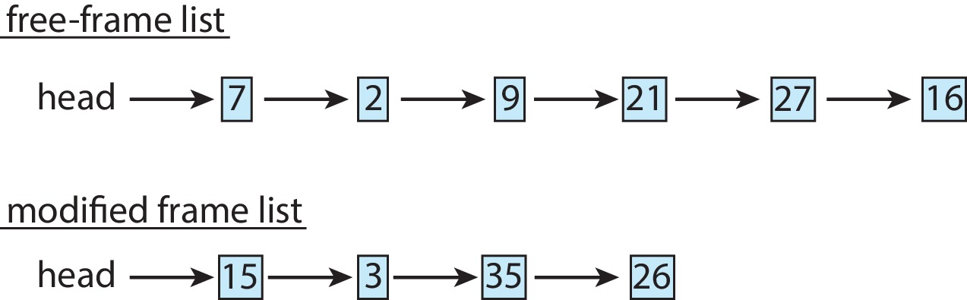
Memory Compression
Memory compression -- rather than paging out modified frames to swap space, we compress several frames into a single frame, enabling the system to reduce memory usage without resorting to swapping pages.
Consider the following free-frame-list consisting of 6 frames
Assume that this number of free frames falls below a certain threshold that triggers page replacement. The replacement algorithm (say, an LRU approximation algorithm) selects four frames -- 15, 3, 35, and 26 to place on the free-frame list. It first places these frames on a modified-frame list. Typically, the modified-frame list would next be written to swap space, making the frames available to the free-frame list. An alternative strategy is to compress a number of frames{\mdash}say, three{\mdash}and store their compressed versions n a single page frame.

Slide 87
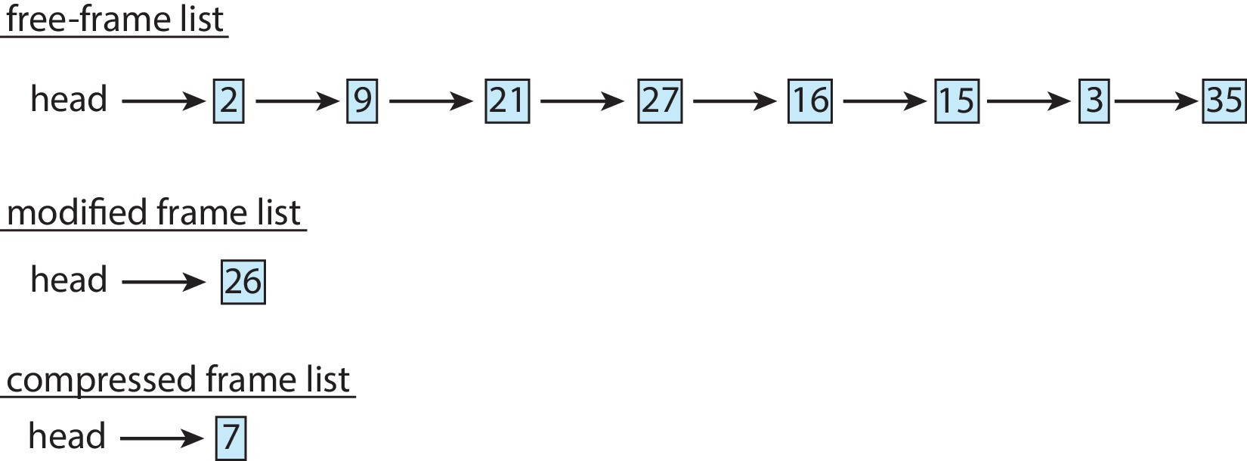
Memory Compression (Cont.)
An alternative to paging is memory compression.
Rather than paging out modified frames to swap space, we compress several frames into a single frame, enabling the system to reduce memory usage without resorting to swapping pages.

